Slide 1
Capstone Data Science Project
Project Name: The Battle of Neighbourhoods
Author: Pankaj Kumar
Date: 14th March 2020
Location: Sydney, Australia

Slide 2
Introduction
Indian food – unique taste, loved by Indians
New York, known for ethnic & cultural diversity
Objective : Utilize Data Science skills to answer :
Which areas in NY have Indian restaurants?
Which is the best location to look for Indian restaurants in NY?
Where should I stay to have multiple options of Indian restaurants around?

Slide 3
Data Analysis:
New York City data
Data source: https://cocl.us/new_york_dataset
2. Indian restaurants in each neighbourhood of New York City.
Data source: Fousquare API
3. GeoSpace data
Data source: https://data.cityofnewyork.us/City-Government/Borough-Boundaries/tqmj-j8zm
Jupyter Notebook link: https://dataplatform.cloud.ibm.com/analytics/notebooks/v2/4ead17c3-f1b0-4030-a167-338a342e8b75/view?access_token=b7666b9afa623224beef42d754490834cd60c48bfc5721d9bd9642672116da5e

Slide 4
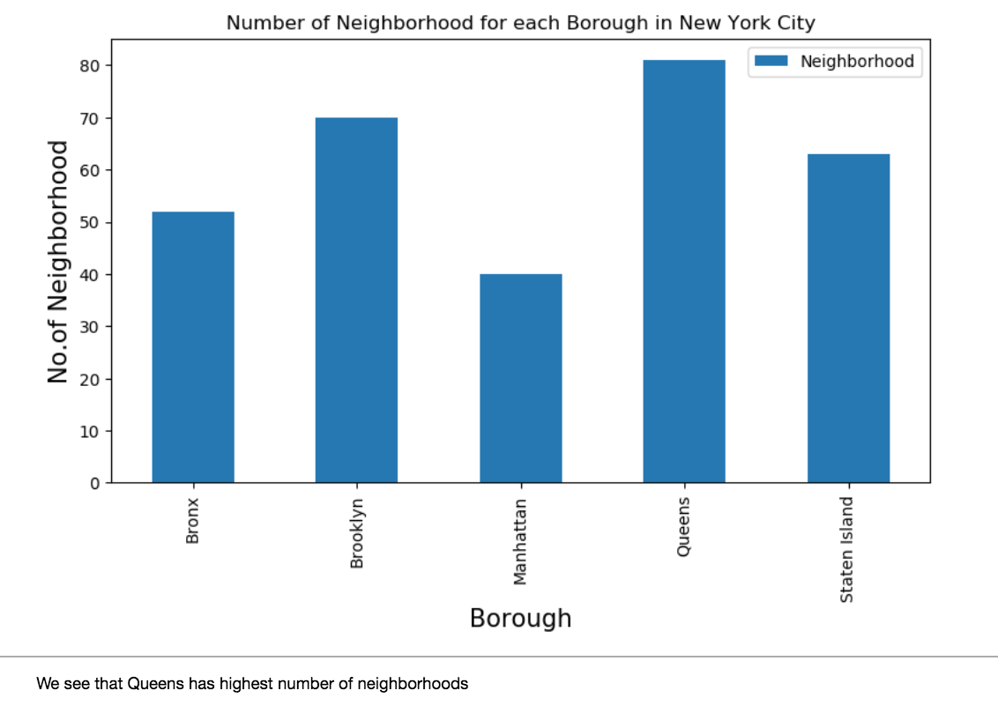
Data Interpretation with observations:
There are total of 306 different Neighbourhoods in New York

Slide 5
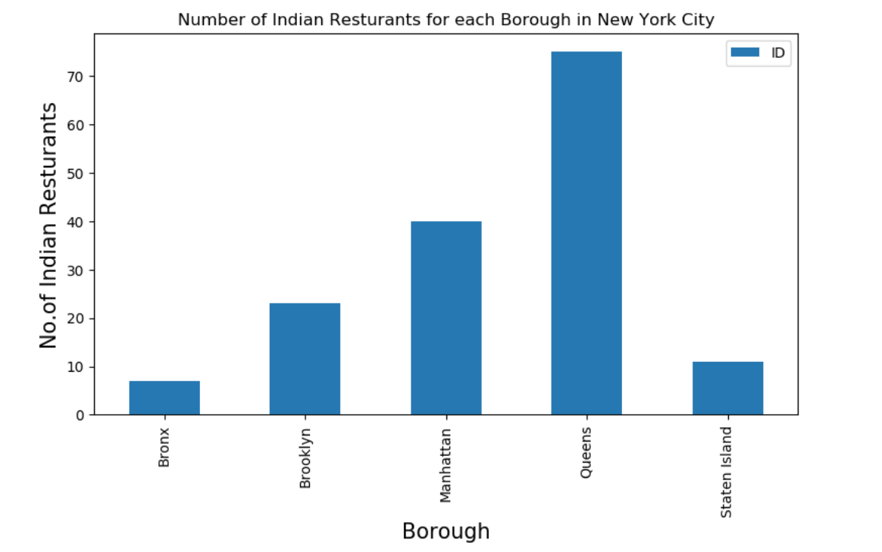
2. 156 Indian Restaurants across New York City boroughs

Slide 6
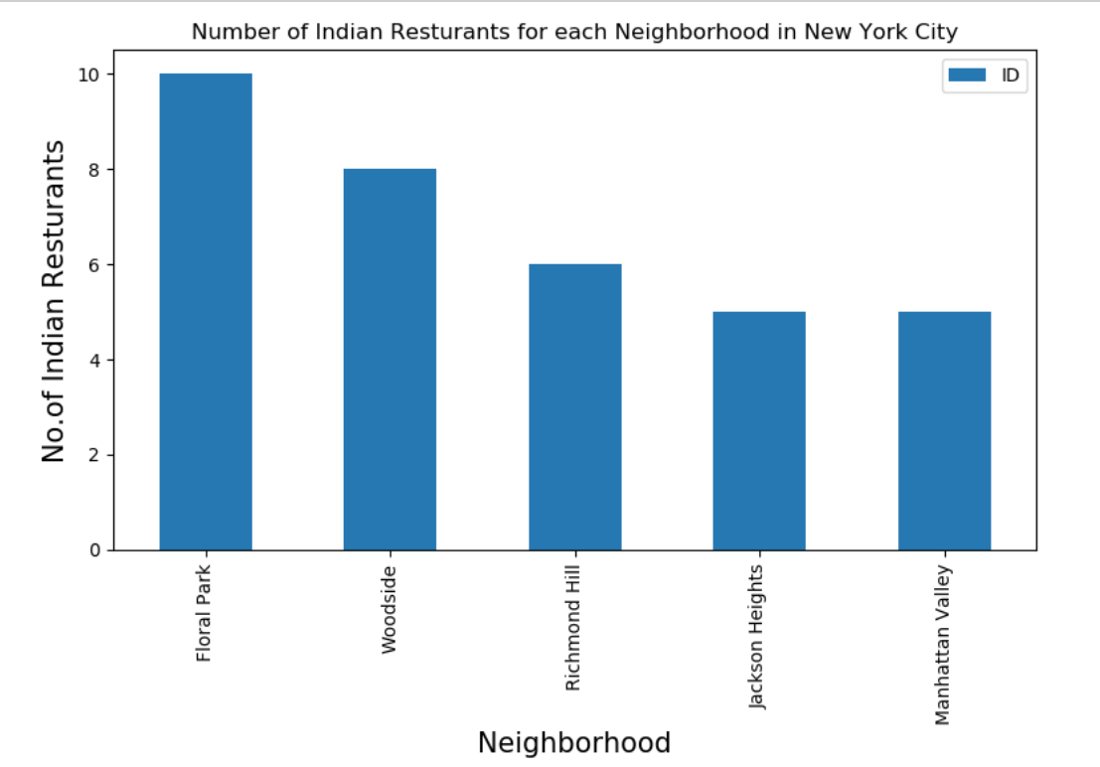
Indian Restaurant Count by Neighbourhood

Slide 7
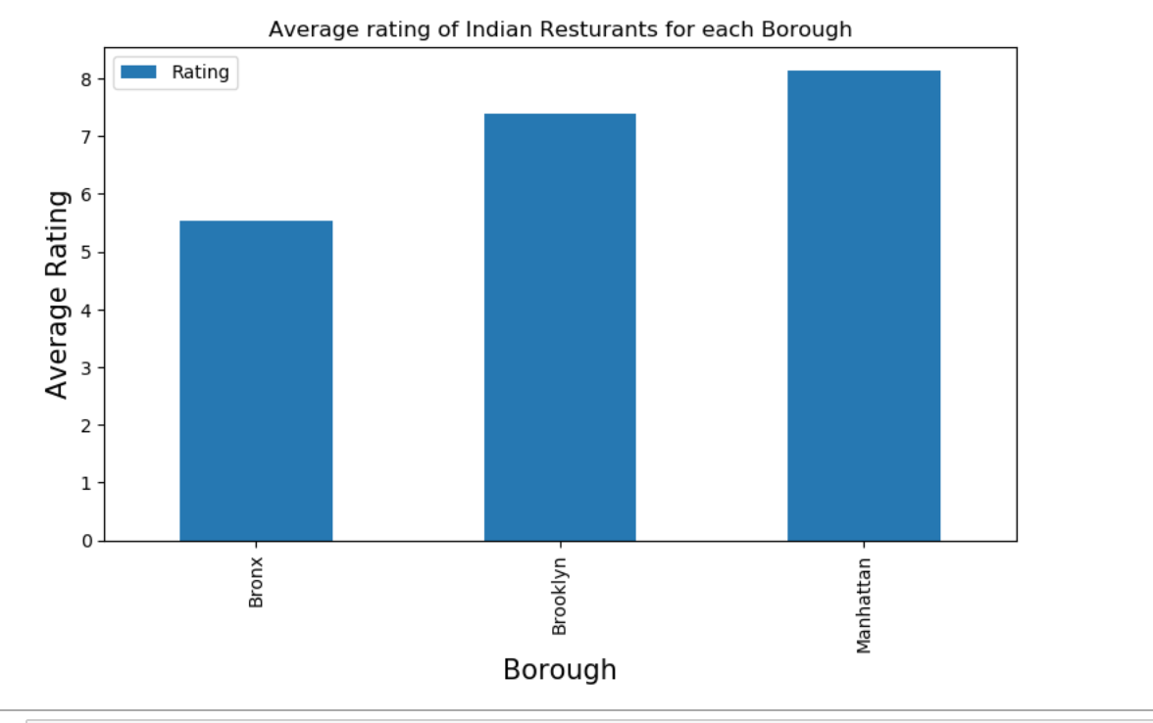
4. Floral Park in Queens has the highest number of Indian Restaurants with a total count of 11.
5. Average rating of Indian Restaurants for each Borough

Slide 8
Conclusion
There are total of 306 different Neighbourhoods in New York
We have 156 Indian Restaurants across New York City
Floral Park in Queens has the highest number of Indian Restaurants with a total count of 11
Tribeca has the highest average rating = 9.1 for Indian restaurants among all neighbourhoods
Top 3 Boroughs with top average ranking of Indian restaurants are: Manhattan (8.13), Brooklyn (7.39) and Bronx (5.53)
I would like to choose Tribeca as my preferred location of best-rated Indian Restaurant in New York.

